Slide 1
Retail Business Performance & Profitability Analysis
Dashboard Design: An End-to-End Data Analytics Project Using Excel, SQL, Python & Tableau
Dataset: Retail Transaction Datasets
Domain: Data Analytics / Business Intelligence
Prepared by: [Nitesh Prajapati]

Slide 2
Executive Summary
This project focuses on analyzing retail transactional data to evaluate overall business performance, profitability, sales trends, customer behavior, regional performance, product profitability, and operational patterns.
The analysis was performed using Excel/CSV for data handling, SQL for structured data analysis, Python (Pandas and Seaborn) for data cleaning and exploratory analysis, and Tableau for interactive visualization and dashboard development.
The dataset contains approximately 301,000 retail transactions with information related to customers, products, regions, sales, cost, gross profit, inventory days, shipping, payment methods, order status, and customer ratings.
The analysis identified key business patterns such as high sales contribution from Electronics and Grocery, strong regional performance from North America, and higher profitability margins within the Books category. The final Tableau dashboard provides interactive KPIs, filters, trends, product profitability analysis, regional analysis, customer-segment analysis, order-status analysis, and inventory-profitability insights.
The project demonstrates an end-to-end data analytics workflow from raw transactional data preparation to business insights and interactive dashboard reporting.

Slide 3
Project Objective
The main objective of this project is to analyze retail business data and identify the key factors affecting sales performance and profitability.
The project aims to:
Analyze overall sales, gross profit, profit margin, orders, quantity, and average order value.
Identify the most profitable and highest-selling product categories and product types.
Compare sales and profitability across different regions and countries.
Analyze monthly and seasonal sales trends.
Understand customer-segment performance.
Analyze order-status and operational patterns.
Examine the relationship between inventory days and profitability.
Identify business areas that may require improvement.
Develop an interactive Tableau dashboard to help stakeholders monitor business performance and make data-driven decisions.

Slide 4
Dataset Description
Item | Details
Dataset | Retail Transactional Datasets
Records | 30,1000
Columns | 24
Time Period | 2023-24
Data Type | Transactional/Business Data
Domain | Retail
Visualization Tool | Tableau

Slide 5
Tools & Technologies
Tool | Purpose
Excel/CSV | Initial data handling
SQL | Data querying and business analysis
Python | Data cleaning & EDA
Pandas | Data manipulation
Seaborn/Matplotlib | Exploratory visualization
Tableau | Interactive dashboard and visualization

Slide 6
Data Preparation & Cleaning
The raw retail dataset was first inspected to understand its structure, data types, missing values, duplicate records, and numerical inconsistencies.
The following data preparation activities were performed:
Checked the dataset structure and column data types.
Converted Order_Date into a proper datetime format.
Identified missing values across categorical and numerical columns.
Replaced appropriate missing categorical values with "Unknown".
Checked numerical columns for negative or invalid values.
Reviewed duplicate Customer_ID values and transaction-level consistency.
Validated sales, COGS, and gross profit fields.
Prepared the cleaned dataset for SQL analysis, Python EDA, and Tableau visualization.
After cleaning, the dataset was suitable for further analysis and dashboard development.

Slide 7
Analytical Approach
Raw Data
Cleaning
SQL Analysis
Python-EDA
Conclusion
Recommendation
Business Insights
Tableau Visualization

Slide 8
SQL Analysis
SQL was used to perform structured business analysis on the cleaned retail dataset.
The analysis focused on:
Total sales and gross profit calculation
Category-wise sales and profitability
Regional sales performance
Product-level profitability
Monthly sales trends
Customer-segment performance
Order-status analysis
Aggregation and ranking of products based on gross profit
SQL helped transform transaction-level data into meaningful business-level metrics that could later be visualized in Tableau.

Slide 9
Python Exploratory Data Analysis
Python was used for exploratory data analysis after the data-cleaning stage.
Using Pandas, the dataset was inspected, transformed, and aggregated to identify important business patterns. Seaborn and Matplotlib were used to explore sales, profitability, regional performance, product categories, and other business variables.
The exploratory analysis helped identify patterns and potential business insights before developing the final Tableau dashboard.

Slide 10
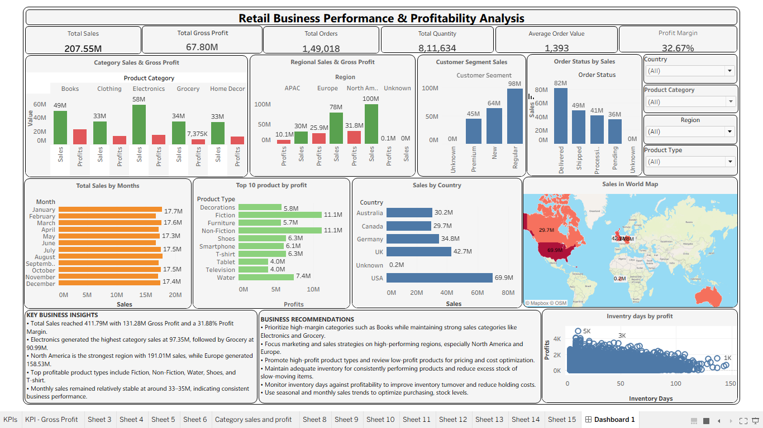
Dashboard Visualizations

Slide 11
Key Business Insights
Overall Performance
₹411.79M Sales and ₹131.28M Gross Profit indicate strong overall business performance.
Category Performance
Electronics generated the highest category sales at approximately ₹97.35M.
Profitability
Books achieved the highest category profit margin at approximately 45%, indicating strong profitability efficiency.
Regional Performance
North America was the highest-selling region with approximately ₹191.01M in sales.
Monthly Stability
Monthly sales remained relatively stable, generally around ₹33M–₹35M, suggesting consistent demand throughout the analyzed period.

Slide 12
Business Recommendations
Based on the analysis, the following recommendations can be considered:
Focus on High-Sales Categories:
Electronics and Grocery generate substantial revenue and should receive continued attention in inventory planning, promotions, and sales strategies.
Promote High-Margin Products:
Books demonstrate strong profitability margins. Similar high-margin products can be identified and promoted to improve overall profit efficiency.
Strengthen the North American Market:
Since North America contributes the highest sales, targeted campaigns and customer-retention strategies can be used to further strengthen this market.
Monitor Pending and Processing Orders:
A significant number of orders are still in Pending or Processing status. Improving fulfillment monitoring can help reduce operational delays.
Optimize Inventory:
Inventory Days vs Profitability analysis should be monitored to identify products with excessive holding periods and optimize stock levels.

Slide 13
Conclusion
The Retail Business Performance & Profitability Analysis project successfully transformed raw transactional data into meaningful business insights using Excel/CSV, SQL, Python, and Tableau.
The analysis provided a clear understanding of overall sales and profitability, category performance, regional contribution, customer segments, order status, product profitability, and inventory-related patterns.
The final Tableau dashboard provides an interactive and user-friendly way to monitor key business KPIs and explore performance using multiple filters.
Overall, the project demonstrates an end-to-end data analytics workflow and shows how data can be converted into actionable insights to support better business and operational decisions.

